Slide 1





RECRUITMENT
PACK
W W W . H A R L O W P L A Y H O U S E . C O . U K
H A R L O W P L A Y H O U S E

Slide 2
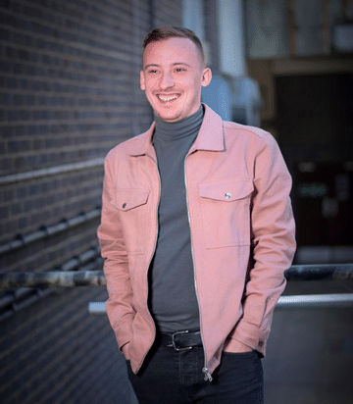
HELLO &
WELCOME
MESSAGE FROM THE ARTISTIC DIRECTOR
Thank you for your interest in the Finance Manager position at Harlow Playhouse. We are excited to welcome a new member to our dedicated team, and I’m thrilled to share with you a bit about who we are and what we stand for.
At Harlow Playhouse, we believe in the transformative power of the arts. Our theatre is not just a venue; it is a vibrant community hub where creativity thrives and diverse voices are celebrated. From our innovative productions to our community outreach programs, every aspect of our work is driven by a commitment to artistic excellence and inclusivity.
None of this would be possible without the exceptional team of people who work here. The finance role is key to our goal of efficient service delivery. The successful candidate will be part of a respected and dynamic team at a venue with a strong community focus, you will join us at a time of exciting growth and local development and have an opportunity to influence the financial strategy and success of a key cultural institution.
People are centre stage of everything we do at Harlow Playhouse, and we built our culture on our core values; relevant, resilient, inspiring, innovative. Everyone is welcome at Harlow Playhouse, whatever your background or experience, and we look forward to your application.
Best of luck!
Rory

Slide 3
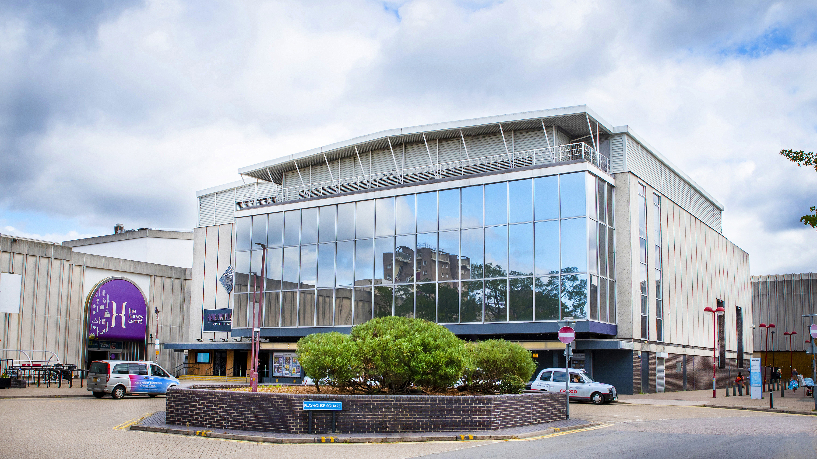
ABOUT US
Harlow is one of the most economically productive and fastest-growing places in the UK. Arts and Culture is significant in Harlow’s history, today and in the future.
Harlow has an impressive history as far as the arts are concerned, stretching right back to the town’s beginnings. Long before The Playhouse was opened, there were numerous local groups covering all aspects of the arts, especially drama. At one time, over 15 drama groups were operating in Harlow, and the competition between them meant that standards became extremely high – so high, in fact, that Harlow companies regularly took the main awards at the annual British Drama League Festivals.
Music also has always been very important in Harlow – the Alberni String Quartet were the town’s own professional musicians-in-residence and are now world-famous, while groups like Harlow Chorus and Netteswell Band continue to live up to their reputation for excellence. Dance, particularly ballet, has had a strong presence in Harlow since Leo Kersley established the town’s first ballet school in 1959.
The Playhouse was the result of a long campaign for a proper venue for all the performing arts. In November 1957, a Theatre Working Party was set up by local theatrical figures, but it wasn’t until April 1970 that the foundation stone for The Playhouse was finally laid by Jennie Lee, then Minister for the Arts.

Slide 4

The theatre was to be a service of Harlow Council, as it still is today, and the building of it was to be funded by a number of bodies, including Harlow Development Corporation, the Arts Council of Great Britain, the British Film Institute and Essex County Council. The first Box Office (a hut which stood where the shop Iceland is now) opened in June 1971, and The Playhouse itself finally opened on 1st November 1971 with a Gala Show starring the young Scottish entertainer, Lulu.
Rory Davies (Artistic Director) now leads a talented and dedicated team of around 20 full and part time staff, and we employ a vast pool of freelance artists, practitioners, casual staff, and volunteers. We provide a programme of quality wide-ranging work across our 400-seat and 120-seat theatres, as well as other reach-out locations, and provide space and support to many artists, groups and companies throughout the year in our three dynamic studio spaces.
As a leading cultural hub Harlow Playhouse continues to commission, produce, co-produce, seed-fund and support a number of artists. We encourage our participants to use Arts and Culture to support their healthy living as a self-help service providing signposting as a first line intervention. We also support young people in accessing and participating in arts programmes through our local and national cultural partnerships.
Our mission at Harlow Playhouse is to create a vibrant, wide ranging programme; work with a social conscience, healthy living, positive wellbeing, and provide a platform for participation in the arts.
Relevant – Resilient – Inspiring - Innovative

Slide 5
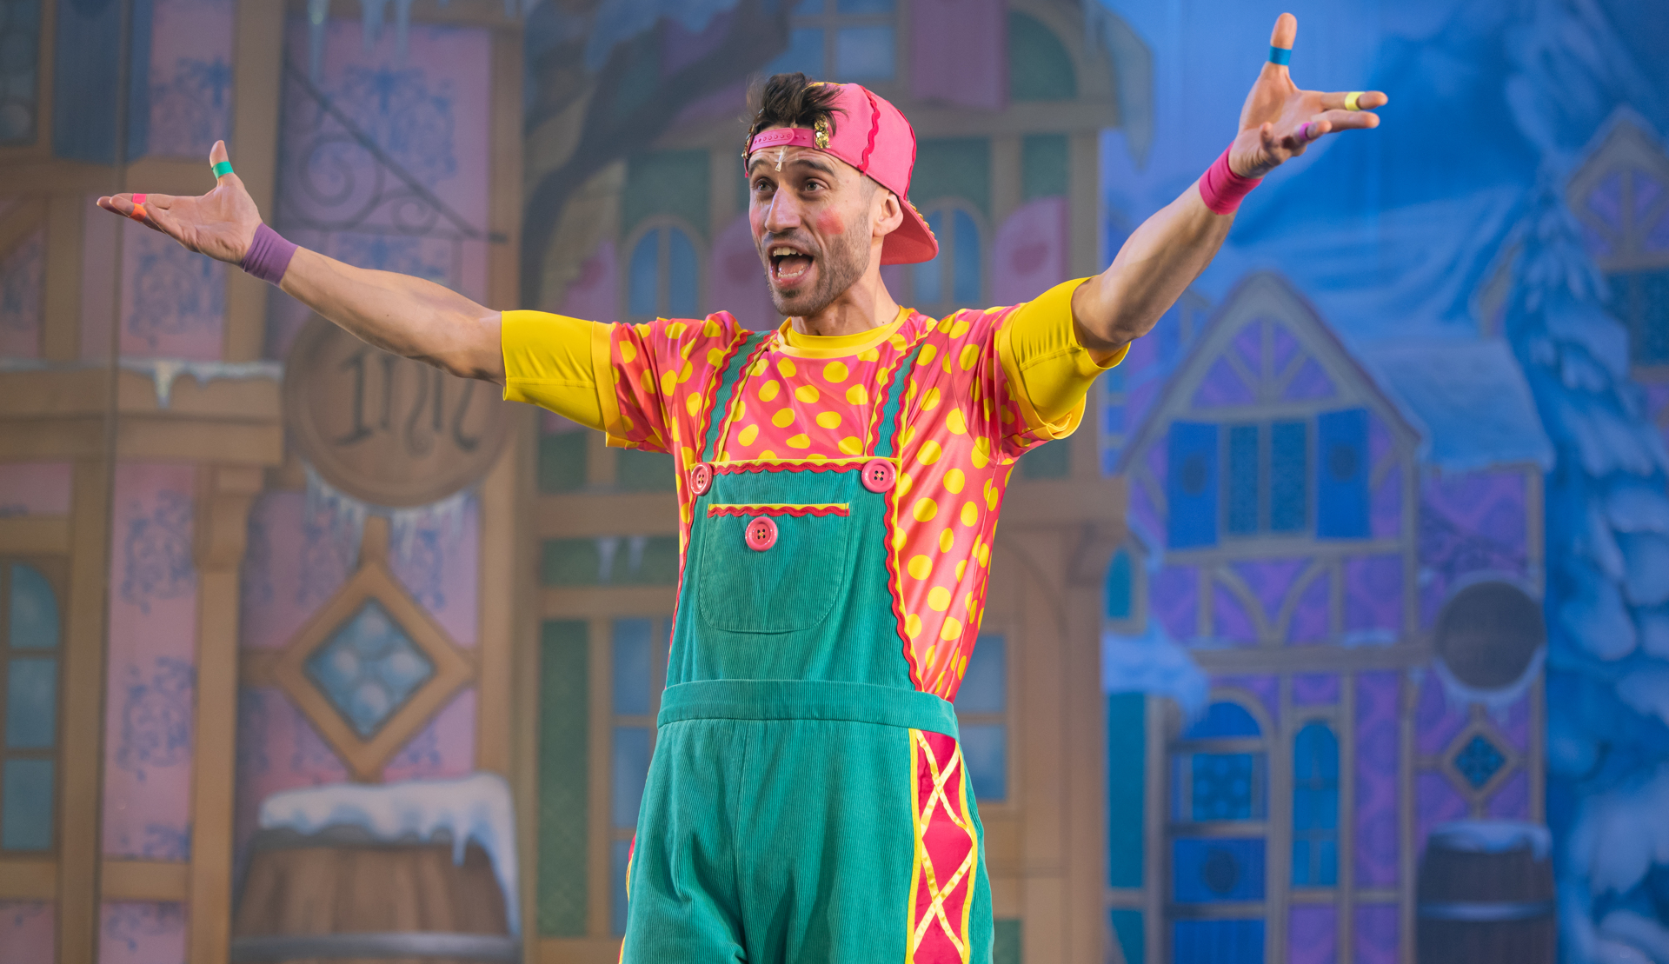
WORKING WITH US & BENEFITS
Pay
We offer competitive salaries, in line with the National Joint Council for Local government Services. As a Living Wage Employer, we offer at least the real living wage to all our employees.
Annual Leave
You can get from 27 to 36 days leave, plus bank holidays, depending on your job, grade and length of time you have worked with us. We also have a shut-down period between Christmas and New Year.
Disability Confident
We are a Disability Confident Employer, committed to inclusion and diversity in our workplace and will offer an interview to disabled people who meet the minimum criteria for the job. We regularly support employees with access to work requirements.
Flexi time
One of the most popular benefits. Our full-time working week is 37.5 hours and if the post if eligibly for flexible working, you can work your 37.5 hours anytime between 8am and 6pm, Monday to Friday.
Hybrid and Flexible Working
We offer hybrid working to many of our staff where possible. Full-time staff will usually come into the workplace for a minimum of 2 of their working days per week (pro rata for part time staff).

Slide 6

Pension Scheme
Our employees are enrolled in the Local Government Pension Scheme, a contributory scheme with staff contributing a percentage of their annual salary.
Training and Development
We provide a wide range of training and development opportunities for staff in all aspects of their work, ranging from in-house IT courses to professional qualifications. We also pay professional fees for approved professions.
Discount shopping services
We offer access to an employee benefits scheme with various discounts and cash back schemes at a arrange of national retailers as well as local businesses.
Cycle to work scheme
Allows you to spend up for £1000 on bikes and equipment, tax-free and spread the cost over monthly instalments.
Health and Wellbeing
We have an Employee Assistance Programme which provides help and support to employees who may be going through a difficult time.
We have Workplace Champions, who work together to develop a programme of activities, exercise classes and events designed to promote health and wellbeing.
Volunteering
You are able to take half a working day off to volunteer in the community with a charity, voluntary or not-for-profit organisation based in Harlow, or one that serves the Harlow area.

Slide 7
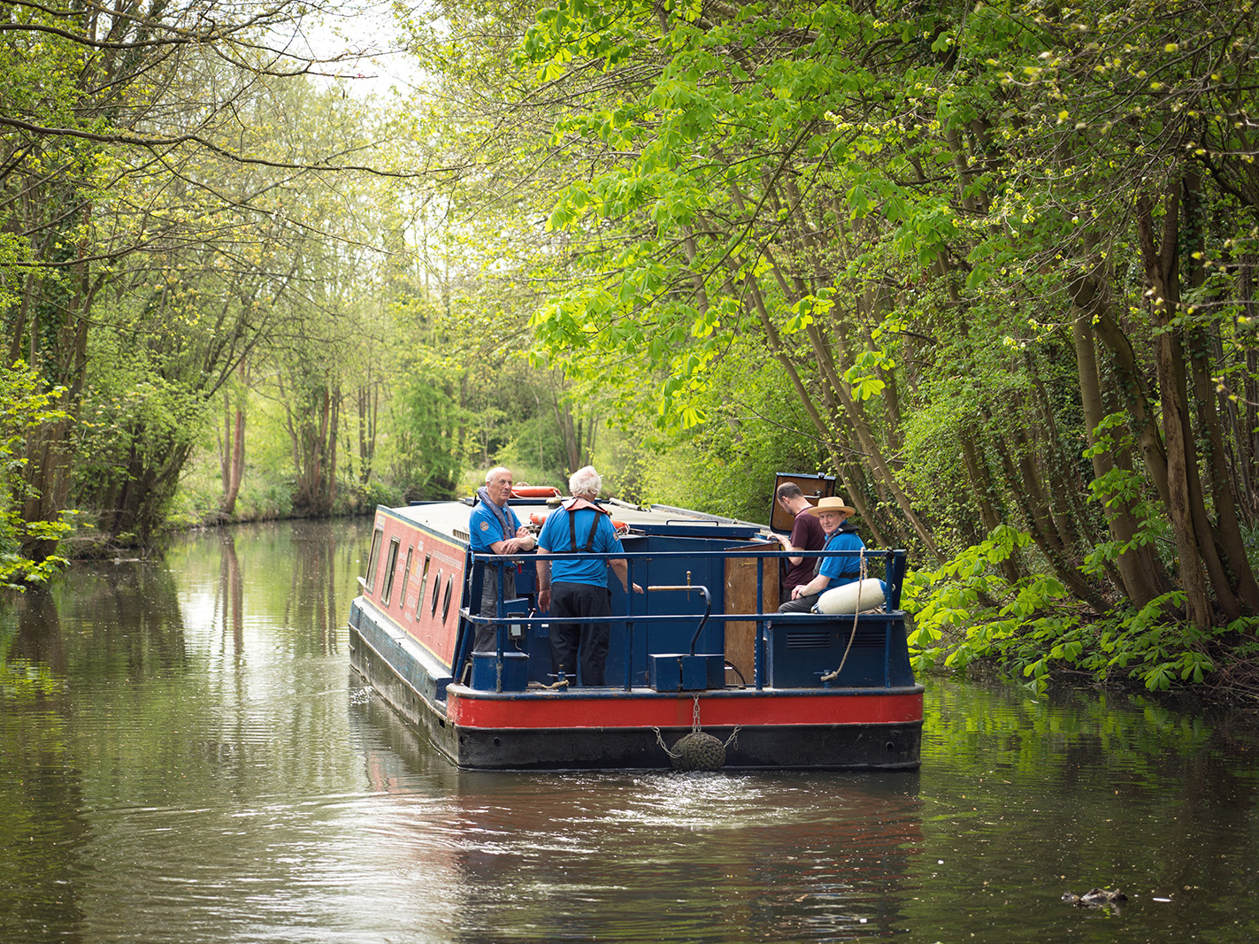
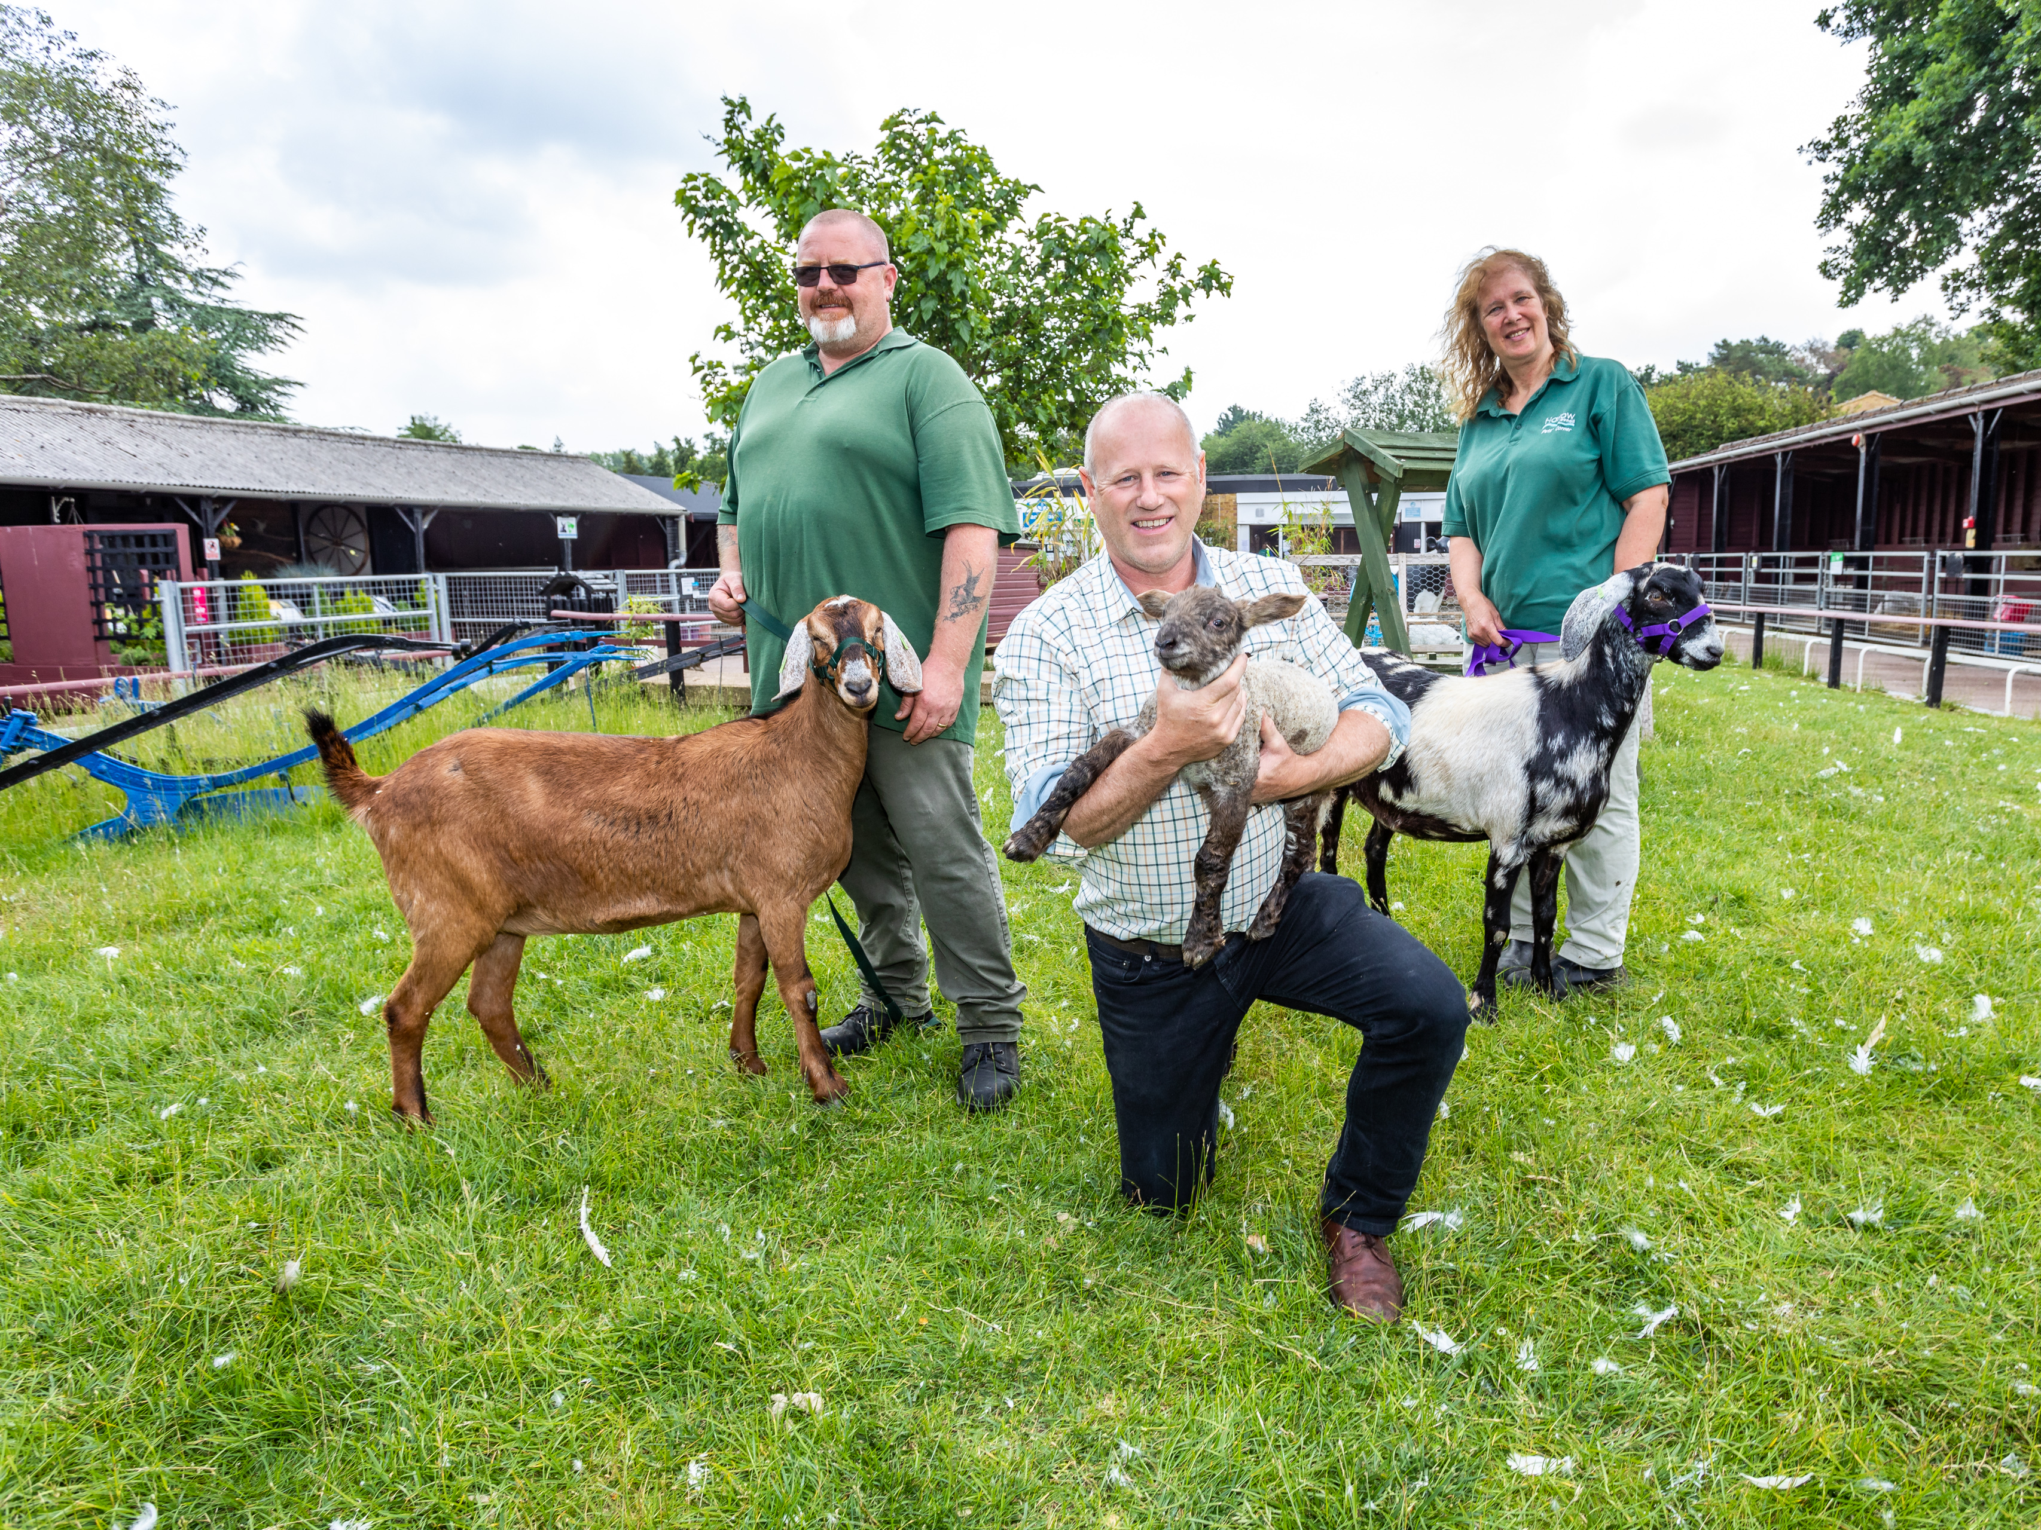
LIVING
IN HARLOW
Harlow is a hot spot for new homes and jobs, offering affordability in a brilliantly connected location, under 30 minutes from London
So much is coming to Harlow – major housing schemes are underway and planned, resulting in over 20,000 new homes, town centre regeneration is about to take off, a new hospital and medical campus, the re-location of the UK Health Security Agency, and the continued development of the Harlow Enterprise Zone and the Harlow Innovation Park bringing new businesses and jobs.
As part of the Harlow and Gilston Garden Town project, 16,000 new homes will be built by 2033 and a further 7,000 will be built in the Gilston area beyond 2033. Increasing the number of homes currently in Harlow from approximately 37,000 to approximately 60,000.
The new development will add lots of additional choice of excellent places to live, including town centre apartments, beautiful new urban communities, and a series of brand new villages, with vast areas of open space and the River Stort Valley on the door step.
As part of the proposed growth, there will be major investment in transport, jobs and community infrastructure, including schools and health facilities, to support new and existing residents in the Harlow area.
Harlow is also well known for its fabulous sculpture collection and most people are surprised at just how green Harlow is, both within the town and in the surrounding countryside.
With a focus on healthy living and well-being, Harlow provides modern families with a lifestyle choice.

Slide 8
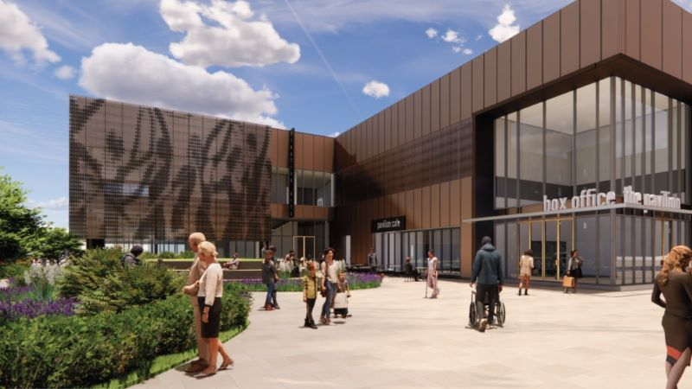
In 2023, Harlow Council secured £19.6m of government funding to transform and regenerate Playhouse Square and College Square.
Harlow Playhouse will be extended with a new arts-led centre which will include a new performance space for live entertainment, a music school and recording studio, a contemporary cafe, a restaurant and a bar.
Thousands of residents have been involved in the design of the new scheme, both before the bid was made to the Government, and since the money has been awarded with many having a say on the plans by visiting the council’s Discover Harlow Hub in the Harvey Centre.
The scheme, which is being funded by the Government’s Levelling Up Fund, will form a new western gateway as part of the regeneration of Harlow town centre.
The scheme will complement Harlow Playhouse’s current offer as well as bring forward a range of new and improved spaces such as:
Flexible live performance and exhibition spaces
New café/restaurant and booking office for the Playhouse
Music school and recording studios
Flexible studio spaces for commercial and community use
New location for the Gibberd Gallery
Improved public realm to provide opportunities for performances and a new public square and pocket-park
Upgrades to the Haydens Road underpass
47 high-quality residential apartments

